Slide 1

Writing a literature review
Angela Manser
PG Academic Writing Tutor

Slide 2
Dissertation Structure
Title Page
Abstract
Table of Contents
Table of Figures
Introduction
Literature Review
Methodology
Data Analysis/Results
Discussion of Results
Conclusions
Appendices
Bibliography
Learning outcomes assessed:
You will be required to research into your current chosen topic, this is an area where you will explore previous research that has been conducted that can contribute and assist you. It should give you a base and help determine the nature of your research.

Slide 3

What we mean by “Literature”…
“Literature” means publications or projects published on a particular topic, such as books, journal articles, research reports, dissertations, government reports…
As students, your job is to search for sources like a detective to find the most reliable, appropriate and relevant material for your project.

Slide 4
The literature review:
1. Is a set of summaries from different sources.
?
x
2. Integrates or synthesises the main ideas and debates around a topic, including your own reflection.
Which of these statements are TRUE and which FALSE?
V
3. Is an introduction to a topic
.
x
4. Discusses the similarities and differences of ideas around the topic.
V
5. Helps to identify the key disagreements around a topic for future consideration.
V
Adapted from: RMIT. Study & Learning Centre (2005) ‘’Writing a literature review’. Available at: https://www.dlsweb.rmit.edu.au/lsu/content/2_assessmenttasks/assess_tuts/lit_review_LL/writing.html (accessed 11/02/2016)

Slide 5

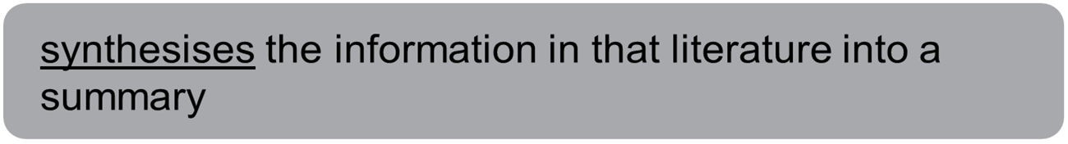
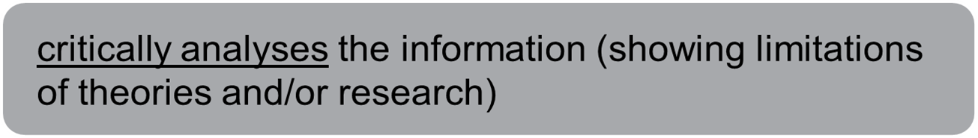

The Purpose of a Literature Review
(Royal Literary Fund, 2015)

Slide 6

The literature review is not…
Everything you have read about a topic.
OR
An explanation of why your project is very important or better than others.
OR
Simply a descriptive, chronological list of other people’s designs or projects.
It is a critical analysis of the information you gathered, identifying gaps in current knowledge; by showing limitations of previous projects or solutions offered.

Slide 7

How do you start?
Actively reading the literature

Slide 8



Approaching academic reading (discuss what you think)
Useful? Not useful? Partly useful?
Predicting content from the title
Using a dictionary
Predicting content from the book or journal details
Asking Google
Focussing closely on the abstract or introduction
Ignoring unfamiliar words initially
Reading the first and last sentences of each paragraph or section in the first instance
Noting down my questions on the topic
Caution! A writer will usually offer definitions of key terms.
Caution! Does Google know the context? Might confuse matters!
Notes:
P. 75. Opportunity to review and discuss how well the strategies advised on PASHE may be helping (or not)

Slide 9
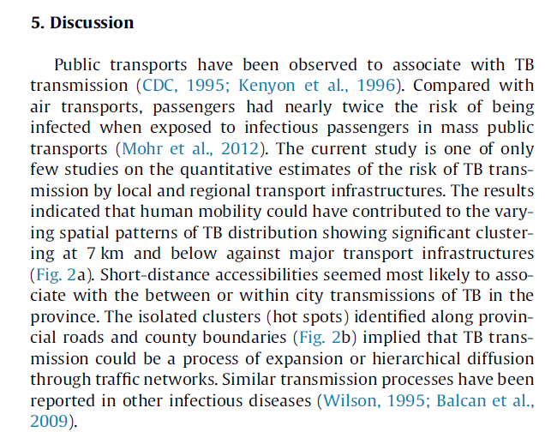
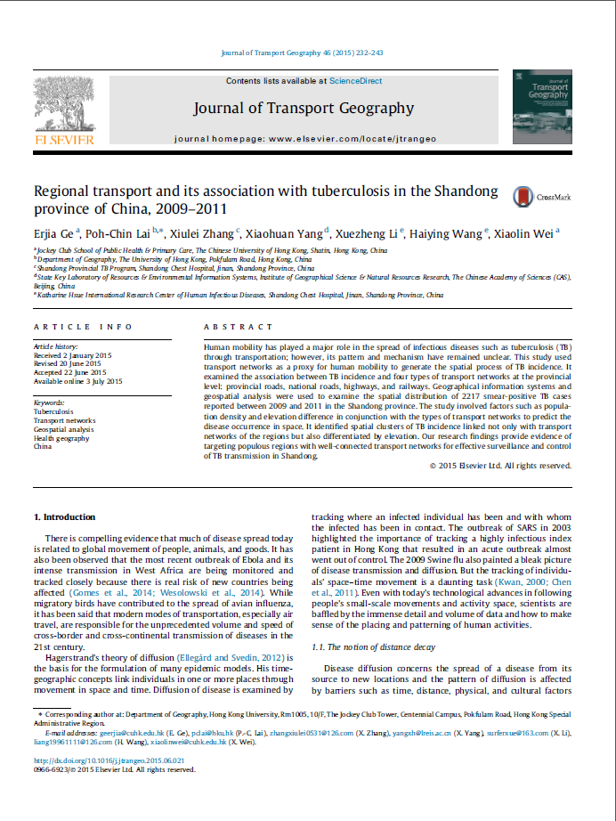
Active reading (1)
Pay attention to the first & last sentence in each paragraph.

Slide 10
How to Read the articles
Read selectively.
Don't start by reading the articles from beginning to end.
First, read just the abstract / keywords / subheadings / conclusion to get an overview of the study and identify the main themes.
Scan the article to identify the answers to these “Why-What-What-What” questions:
Why did they do the study? Why does it matter?
Introduction: the research question
(2) What did they do?
Methods
(3) What did they find?
Results
(4) What does it mean?
Discussion

Slide 11
Questions to Consider and Elements to Include in your literature review:
Why is it important to investigate this issue?
What is the motivation for the research?
What has previous research in the area shown? What hasn’t it shown?
Is there a clear gap in the literature?
Why is this study necessary? Is it perhaps a partial replication of an earlier study being carried out with a different sample of participants?
What will be the potential importance/significance of your research findings? In other words, why do we care?
This section should provide a clear rationale as to why you are carrying out the study. You should have a clear set of aims and a clear and sensible research question. The research question should logically relate to the literature set out in your review.
–

Slide 12
How to Organise your Notes
You may wish to create a summary sheet of each article’s key points.
This will help you to integrate each article into your paper and synthesise their arguments together.

Slide 13
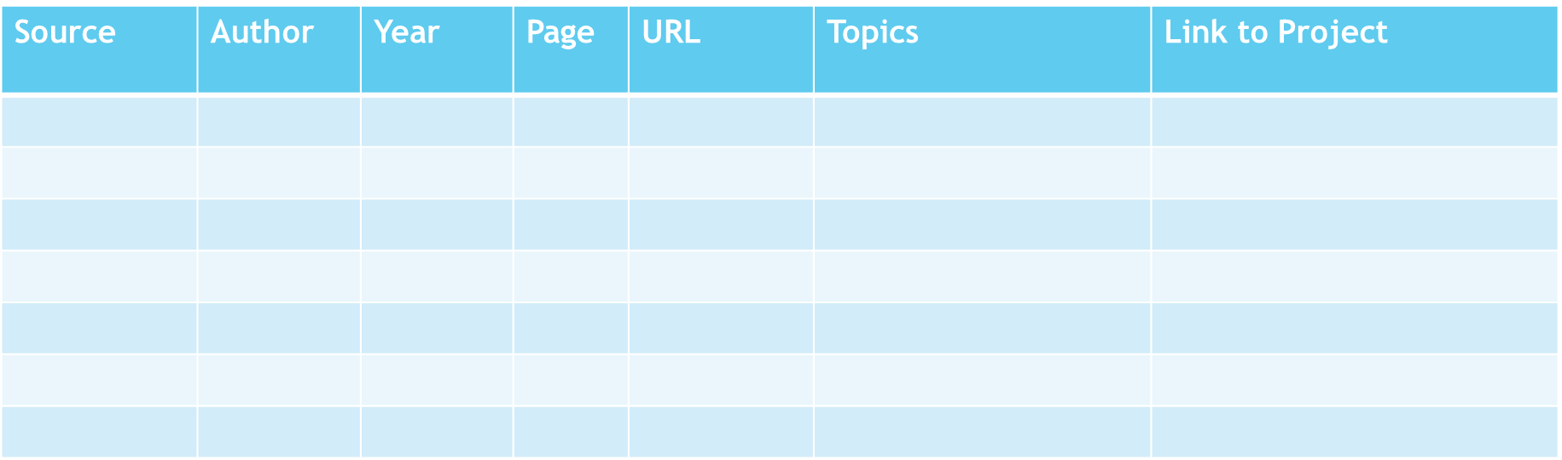
Noting information down: organisation is key!
Structured notetaking helps you keep your notes organised & avoid plagiarism.
http://www.citethemrightonline.com/

Slide 14

A literature review can be seen as a dialogue organised by you around a table
Cheong (2015)
Peterson (2010)
Hussein (2008)
Your topic
YOU
Hussein (2008) explains that … However, Cheong (2015) challenges this idea … Similarly Peterson (2010) defends that … The concept of identity used in my research is in agreement with …
Abidakun (2011)

Slide 15
Organising your ideas is important.
Your literature review, should be organized around ideas, not the sources themselves as an annotated bibliography would be organized. This means that you will not just simply list your sources and go into detail about each one of them, one at a time. As you read widely but selectively in your topic area, consider instead what themes or issues connect your sources together.
Consider what is the most effective way of presenting the information? What are the most important topics, subtopics, etc., that your review needs to include? And in what order should you present them? Develop an organization for your review early, (it can be changed as your work develops but you must have a guiding organisation from the start).

Slide 16

Your literature review should
Give the context: Briefly survey the work that other researchers have done previously.
Organization by topic: Identify key areas / themes / solutions that previous researchers have introduced and discuss their strengths and weaknesses, or limitations.
Explain how your project/ design/ solution builds on and differs from the work that was done previously.

Slide 17
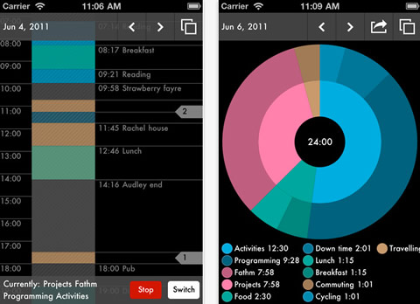
An example: A time management app for UEL students…
Imagine that you picked this topic.
What kind of questions might you ask to start with?

Slide 18
Sample literature review structure
Background information: Overview of time management tools (print and online tools)
Analysis:
Key theme 1 (needs of university students in managing time)
Key theme 2 (comparison of strengths/ limitations of all time management apps available on the market)
Key theme 3 (comparison of strengths/ limitations of time management apps for students)
3) Your project /solution/ approach (how my app will specifically address UEL students’ needs)

Slide 19
A Possible structure
1. Background information/introduction: overview of theories/ research
2. Analysis:
Key theme 1 (review of research -issues)
Key theme 2 ( review of research - issues)
Key theme 3 (review of research - issues)
…
3. The significance of your project / approach (how it fills the gap in research!)
Paragraphs!

Slide 20

Check for clarity and coherence
When writing your literature review, pay close attention to your verb tenses to ensure clarity and coherence. Use the present tense when discussing general findings or accepted knowledge (e.g., 'Smith (2020) argues that...’) you can also use the past tense when referring to specific studies or historical developments (e.g., 'Jones (2018) found that...’).
Notice the variety of verbs used below and what they indicate to you as a reader.

Slide 21
Reporting verbs: Present tense example
verbs used to discuss/use others’ ideas within a text*
Unwin (2009) | To say | To talk about | To think | To emphasize | To show | To suggest
 | writes … | discusses … | believes … | stresses… | illustrates … | proposes …
 | states that … | explores … | defends … | highlights | describes … | posits …
 | argues … | analyses … | claims … | accentuates … | outlines … | theorises …
* Adapted from: Chazal, E. & McCarter, S. (2012) ‘Unit 8: Interpretation’ in Oxford EAP. A Course in English for Academic Purposes. Oxford: Oxford University Press, p. 126

Slide 22
Why are the words in red useful?
The use of artificial neural networks for flood forecasting is an area which has yet to be fully explored. Up until now the majority of work in this area has been mainly theoretical; concentrating on neural network performance with artificially generated rainfall- runoff data; for example Minns and Hall (1996). Even so, these theoretical approaches tend to overlook the difficulty in converting and applying actual data to artificial neural network topologies. Hall and Minns (1993) go some way to address this criticism by applying neural networks to a small urban catchment area. However, their discussion is limited to the performance of a neural network on a small number of events.

Slide 23
They help you guide the reader through your writing and make sure the order is clear and flows well.
Often referred to as signposting language
Without signposting language, writing can lose direction, become confused and read like a series of unrelated points.
https://www.ncl.ac.uk/academic-skills-kit/writing/academic-writing/signposting/

Slide 24
Comparing different sources using signifying markers or linking words, enables you to establish a meaningful conversation between the different authors. Does your work flow?
Similarity
Difference
also furthermore
again
similarly
Contrast
Addition
what is more
moreover
additionally
however
though conversely
on the other hand
nonetheless

Slide 25
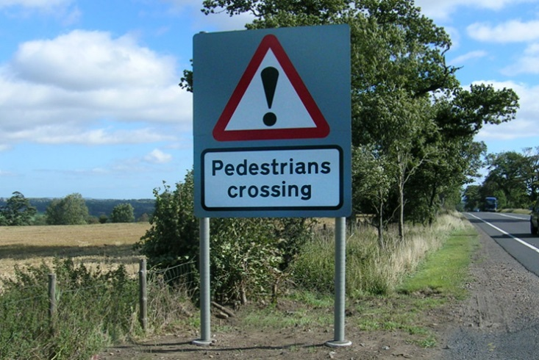
Signposting
Functions
as a result of | logical consequence
firstly | structuring/ordering
for instance | giving examples
getting back to | come back to old idea
however | show a big contrast
in most cases | generalising
in particular | giving examples
in spite of this | show a big contrast
incidentally | move on to new idea
it follows that | logical consequence
nonetheless | show a big contrast
on the contrary | disagree
on the whole | generalising
secondly | structuring/ordering
therefore | logical consequence
Disagree
Move on to an idea
Come back to an old idea
Give examples
Generalise
Show a logical consequence
Show a big contrast
Phrases
Match the phrases to the functions.

Slide 26
Signposting
Functions
as a result of | logical consequence
firstly | structuring/ordering
for instance | giving examples
getting back to | come back to old idea
however | show a big contrast
in most cases | generalising
in particular | giving examples
in spite of this | show a big contrast
incidentally | move on to new idea
it follows that | logical consequence
nonetheless | show a big contrast
on the contrary | disagree
on the whole | generalising
secondly | structuring/ordering
therefore | logical consequence
Phrases
Match the phrases to the functions.

Slide 27
Using the Manchester Phrasebank
Go to Academic Phrasebank | The University of Manchester
Choose one of these starter phrases to write about your literature review.
Look at the other phrases for writing other sections including introduction, methodology and conclusion.
You can use any of the phrases for your own work, you don’t have to cite and reference these phrases.

Slide 28
Some useful phrases for Literature Reviews From the Manchester Phrasebank*
Providing the context
Showing gaps or limitations of previous research
The existing body of research on X suggests that …
Recent evidence suggests that …
It has previously been observed that …
Previous research has established that …
Data from several studies suggest that …
Recently investigators have examined the effects of X on Y.
Surveys such as that conducted by Smith (1988) have shown that …
Studies over the past two decades have provided important information on …
A considerable amount of literature has been published on X. These studies …
Previous studies of X have not dealt with …
Researchers have not treated X in much detail.
Such expositions are unsatisfactory because they …
Most studies in the field of X have only focused on …
Such approaches, however, have failed to address …
Very little is known about X in …
It is still not known whether …
Apart from Smith (2014), there is a general lack of research in …
To date, there are few studies that have investigated the association between …
Emphasizing the significance of your project
This project provides new insights into …
The present study fills a gap in the area of…
This investigation will enhance our understanding of …
There are several important areas where this study makes an original contribution to …
The findings should make an important contribution to the field of ….
Therefore, this study makes a major contribution to research on X by demonstrating …
*Adapted from http://www.phrasebank.manchester.ac.uk/

Slide 29
Use of language: Providing the context
Recent evidence suggests that … It has previously been observed that … Previous research has established that … Data from several studies suggest that … The existing body of research on X suggests that … It is now well established from a variety of studies, that … Recently investigators have examined the effects of X on Y. Surveys such as that conducted by Smith (1988) have shown that … Studies over the past two decades have provided important information on … A considerable amount of literature has been published on X. These studies …
http://www.phrasebank.manchester.ac.uk/

Slide 30
Use of language: Emphasizing the significance of your work
This study provides new insights into … The study offers some important insights into … The present study fills a gap in the literature by … Understanding the link between X and Y will help … This investigation will enhance our understanding of … The findings should make an important contribution to the field of …. This study aims to contribute to this growing area of research by exploring … Therefore, this study makes a major contribution to research on X by demonstrating … There are several important areas where this study makes an original contribution to …

Slide 31

Common problems with literature reviews:
Too vague and general (not specific enough to your specific research questions).
Too few sources consulted and within a limited range.
Use of sources that are not relevant to your specific enquiry.
Lack of debate.
Outdated sources.

Slide 32

An example Literature Review
The focus of a literature review, is to summarize and synthesize the arguments and ideas of others without adding new contributions.
Please read the example of a Literature Review regarding women in STEM fields

Slide 33

Final advice
Do as much reading as you can and early – and don’t leave writing until later, as the process will help cement your understanding of your topic.
Think about how your research fits into existing knowledge and research.
Synthesise, compare, contrast - don't just write up your literature review in a list form - create a synthesis matrix and identify themes to organise the review.
Make a plan of the review structure before you write, even if you change it later.
Record all information for references as you go!

Slide 34
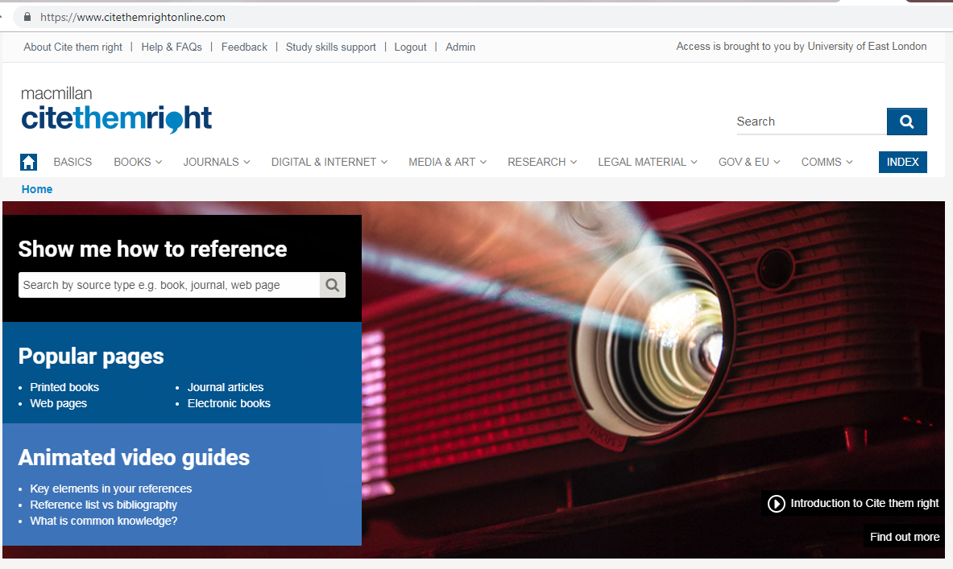

Slide 35

Useful Resources
phrasebank.manchester.ac.uk
https://moodle.uel.ac.uk/mod/page/view.php?id=802139
UEL Moodle-> Student Links-> Study Skills
citethemrightonline.com
Academic writing drop-ins
Every weekday 10am-11am and 1pm-2pm on MS Teams

Slide 36
Apply the test:
Module Guides contain your Core and Recommended readings for each module
UEL Library https://uelac.sharepoint.com/sites/libraryandlearningservices
Google Scholar
Search for books or articles which could be a relevant source for your dissertation

Slide 37

Questions?
If you have any questions email
a.manser@uel.a.cuk

Slide 38



FIND US ON INSTAGRAM

Slide 39

How to find us
Notes:
The latest information about our workshops and other events.
Tips, advice and information on study skills.
Hundreds of interactive resources, worksheets, quizzes, and other useful things to download.
Links to the best skills development websites.
Useful information about how to maximise your study time.
Details on how to contact us.

Slide 40

MyFeedback
Pssst…Did you know that you can get feedback on your written assignments before you submit?
For fast, focused feedback upload your draft written assignments via the Moodle Study Skills tab.
➔ Find us on Moodle ➔ Student Links ➔ Study Skills
Referencing | Structure | Grammar | Spelling

Slide 41

Thanks for listening. Your feedback please:
http://tiny.cc/tutoring24
Dr J. Malik

Slide 42


For your questions, contact us:
tutors@uel.ac.uk
THANK YOU!

